Slide 1
Cognitive Assistant - A mental health tracker built using react native with Machine Learning.
Name: Roll No:
Rohit Raina 117A1058
Abdul Riyaz Ansari 218A1098
Jagadish Murugesan 218A1102
Project guide :
Prof. Kranti Bade

Slide 2
Motivation
Mental health is an important issue in the world today. With a large population now working from home and staying away from loved ones, the mental health situation has deteriorated. As such, it becomes important to track and remedy any problems before they get too serious.

Slide 3
Problem Statement
Most common problems of mental health tracker are the predictive models are mainly based on the old tasks. Same old tasks are given to the user again and again this may lead to the unwillingness to use the app.
So the major aim of this project is to tackle this problem by giving the new tasks every time so that the user continues to use the app and track its mental health. Hence resulting in the improvement of mental health of the user.

Slide 4
Problem Definiton
This project involves building an app that tracks the mental health of its users and tries to help them get through their condition by suggesting tasks and keeping record of their progress with machine learning . There will be a ML model to train on dataset which is related to mental health.
According to the outcome of the Q&A, we'll provide tasks and activities for users based on their current mental state with the help of machine learning.

Slide 5
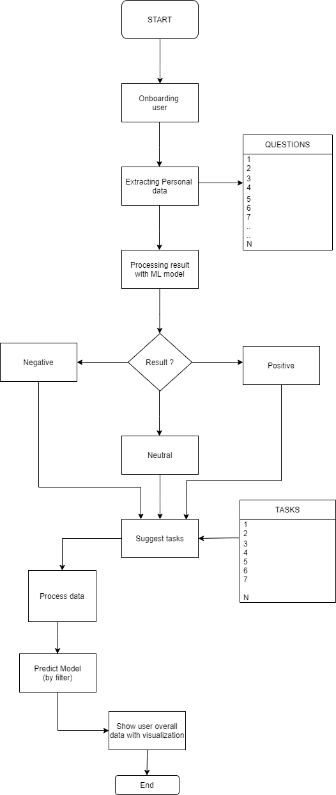
Methodology

Slide 6
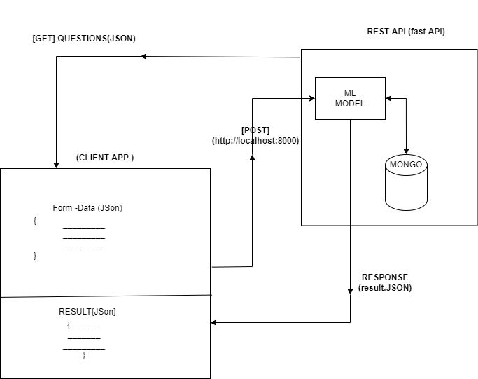
System Design

Slide 7
Objectives
Suggestion of tasks and activities based on the result of the Q&A.
Variation in tasks and activities as per user’s mood.
Notifications will be there so that people with chronic medical illness will not forget self-monitoring.
Journaling and data entry features.
Cross-platform based technology. i.e both iOS ,web as well as Android .
User’s data will be protected and will not be exposed.

Slide 8
Scope
To track the mental health of the user.
To assign tasks and activities to the users based on their current mental state.
To help them get through their condition by suggesting tasks and keeping record of their progress .
To help the user to track and reflect their mental health.

Slide 9
Related Work
Sr. No. | Title | Conference Year | Purpose | Issues
1. | Youth mental health apps in the digital age: a scoping review of trends and evaluations. | 2020 | Given the lack of a detailed scientific methodology for evaluating mobile mental health apps, the group is currently developing a more detailed, rigorous framework that can be used consistently and reliably. Below are the major categories of this framework. • Effectiveness • Design Model with Youth Input • Usability • Privacy • Security • Implementation | The Headspace website claimed around efficacy, including that ten days of use will reduce stress by 14%, and three weeks will reduce aggression 57%

Slide 10
Related Work
Sr. No. | Title | Conference Year | Purpose | Issues
2. | mental health mobile apps work: evidence and recommendations for designing high-efficacy mental health mobile apps | 2018 | As mental health apps are increasingly prescribed to supplement psychiatric treatment and help patients self-manage their mental health conditions, it is key to understand (I) whether, and which, mental health apps have proved effective, and (II) what makes a mental health app effective. | These challenges can broadly be divided into the following categories: (I) poor regulation of quality and privacy; (II) inconsistencies in engagement; (III) narrow focus on one disorder per app to be effective and address these challenges.

Slide 11
Related Work
Sr. No. | Title | Conference Year | Purpose | Issues
3. | Effectiveness of Using Mental Health Mobile Apps as Digital Antidepressants for Reducing Anxiety and Depression. | 2020 | A multiple baseline across-individuals design will be employed. A total of 50 participants will be recruited (10 for each app) who will provide baseline data for 20 days. The sequential introduction of an intervention phase will commence once baseline readings have indicated stability in the measures of participants’ mental health and will proceed for 10 weeks. Postintervention measurements will continue for a further 20 days. Participants will be required to provide daily subjective units of distress (SUDS) ratings via SMS text messages and will complete other measures at 5 different time points, including at 6-month follow-up. | There are some notable shortcomings including substantial heterogeneity across studies. For example, there have been differences in dosage duration of interventions and the absence of long-term follow-up data.

Slide 12
Related Work
Sr. No. | Title | Conference Year | Purpose | Issues
4. | Insights from user reviews to improve mental health apps | 2020 | Available marketplaces such as the App Store for Apple iOS platform and Google Play for Android platform allow users to download apps and evaluate them by providing a rating and writing comments. This publicly available data (user reviews) are regarded as a comprehensive evaluation of the app from the user’s own perspective. These reviews could include both positive and negative feedback and identify specific aspects or qualities that users like and dislike. | The weaknesses of the mental health apps discussed by users were mostly related to usability issues, poor customer service, and unaffordability. Moreover, users complained about the lack of variety of options, personalization, control, trust, and security.

Slide 13
Related Work
Sr. No. | Title | Conference Year | Purpose | Issues
5. | Smartphones in mental health: a critical review of background issues, current status and future concerns | 2020 | One smartphone eliminates the need to carry many devices including a phone, camera, speakers, WiFi adapter, and a GPS system. A smartphone allows the user to download and run applications (apps). The built-in sensors can provide measurements and contextual information, and by integrating communications into an app, the user needs few connectivity skills. | People with chronic medical illness reject self-monitoring, finding it annoying, depressing, a burden, or prefer to forget they are ill . The very process of measurement may hinder enjoyment of physical activities and decrease well-being

Slide 14
Related Work
Sr. No. | Title | Conference Year | Purpose | Issues
6. | Smartphone apps for the treatment of mental health conditions: status and considerations | 2020 | The evidence base for the use of apps in the treatment of mental health conditions is most developed for the treatment of mood disorders. Meta-analytic evidence now supports the modest effectiveness of app-based interventions in improving self-reported symptoms associated with depression and anxiety . In depression, app-based interventions incorporating cognitive behavioural therapy , mood monitoring, and mindfulness are associated with small to moderate effects when compared to inactive controls. A similar effect has been observed in apps for anxiety | Current challenges in the use of apps for mental health treatment are privacy, safety, engagements.

Slide 15
Related Work
Sr. No. | Title | Conference Year | Purpose | Issues
7. | Mobile Apps for Mental Health Issues: Meta-Review of Meta-Analyses | 2020 | Systematic reviews and meta-analyses were searched, specifically for mobile apps on mental health issues or symptoms, and rated using the Grading of Recommendations Assessment, Development and Evaluation system | More meta-analyses and more quality studies are needed to recommend apps for other mental health issues or for specific populations.

Slide 16
Related Work
Sr. No. | Title | Conference Year | Purpose | Issues
8. | A pilot study using a user-centered design self-monitoring application for mental health. | 2020 | The app was designed according to a questionnaire survey conducted before this study. The Mental App was installed on the students’ smartphone and the psychological tests (the Link Stigma Scale, the Center for Epidemiologic Studies Depression Scale, and the 12-item General Health Questionnaire) were performed on the same day. After using the App for two weeks, the students completed a questionnaire survey and underwent the same psychological tests. We compared the results between the app user and non-user group. | This non-randomized controlled pilot study indicates that the app we developed, may provide effective mental health care for university students, even in the short-term.

Slide 17
Related Work
Sr. No. | Title | Conference Year | Purpose | Issues
9. | Mobile apps for Mental Health: a content analysis | 2020 | This study examines multiple dimensions of mental health-related apps available in Google Play Store for four years between 2016 and 2020. We used a set of keywords such as mental health, mental illness, mental disorders, and the cure of mental disorder and the healing of mental illness to search apps available on the play store. We scrapped the data using various software and programming tools. | Relaxation was the common technique used to deal with these concerns. It was difficult to predict the trustworthiness these apps by looking at their rating and the number of people who rated.

Slide 18
Related Work
Sr. No. | Title | Conference Year | Purpose | Issues
10 | The Digital Psychiatrist: In Search of Evidence-Based Apps for Anxiety and Depression | 2019 | The methodology for this mini-review was informed by the AMSTAR and PRISMA protocols for systematic reviews. The coding regime used was based on Alyami et al. and Shen et al. both of whom conducted app marketplace searches for mental health apps. Four researchers, including the lead author, searched the Apple App Store and Google Play store, in December 2018. Previous research had shown that these two marketplaces account for over 90% of available apps for depression . | Most of the applications are payment based.

Slide 19
Problems faced
The predictive models are mainly based on the old tasks.
Lack of journaling and entries.
Either works on Android or iOS.
Current challenges in the use of apps for mental health treatment are privacy, safety.
People with chronic medical illness forget self-monitoring.
Constant reminders for buying premium features instead of providing a clean and straightforward user experience.

Slide 20
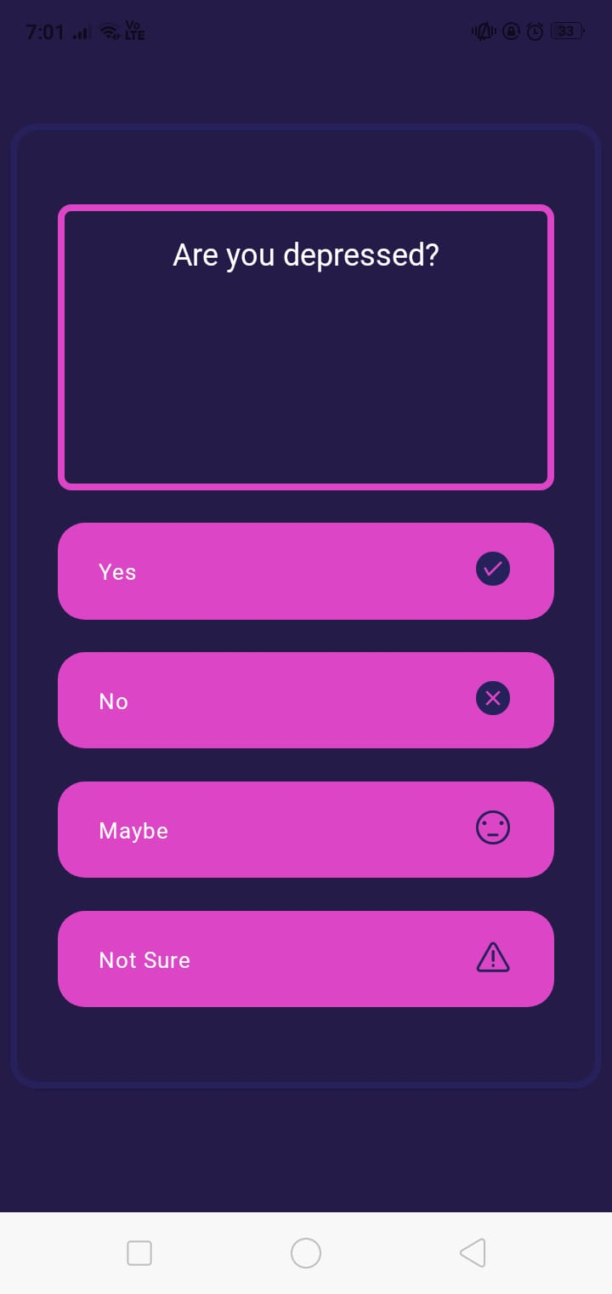
Result

Slide 21
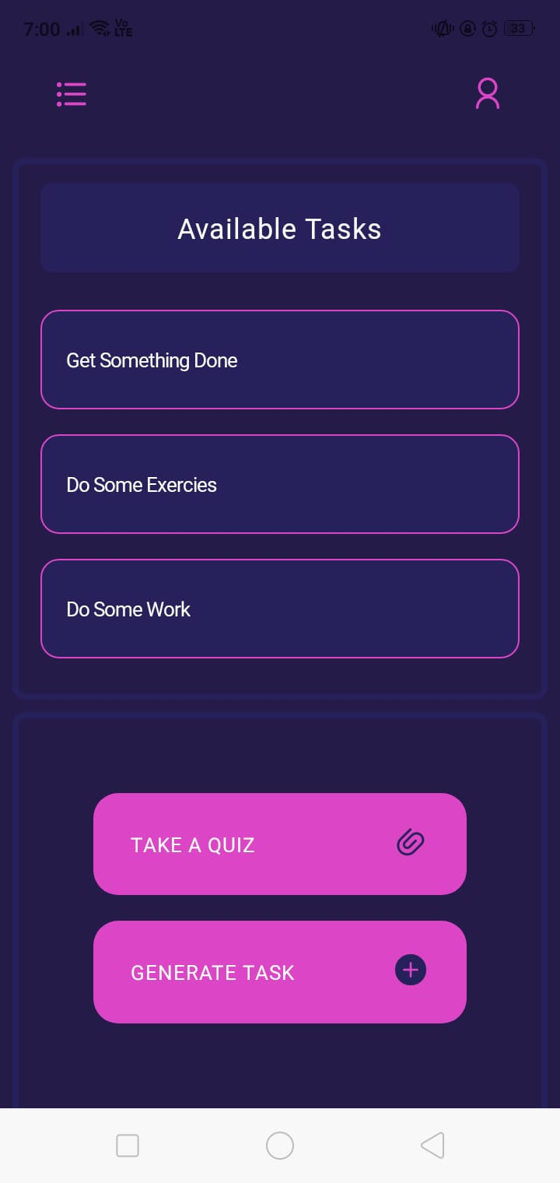
Result

Slide 22
References
[1] Md. Aminul Islam, Naziat Choudhury, “Mobile apps for Mental Health: a content analysis”, 2020 Indian Journal of Mental Health 7(3):222-229
[2] John Christopher Camarines, Teresa Camarines,“The growing role of mental health apps in time of the pandemic”, J Public Health(Oxf) 2021
[3] Yasser Khazaal, “Mental Health apps: innovations and challenges”, 2019 Rev Med Suisse 15(663):1650-1656.
[4] Phil Topham , Praminda Calleb-Solly, “Mental Health App Design”, 2015 Conference: the 17th International Conference DOI:10.1145/2786567.2787136
[5] Julie M Robillard , Tanya Feng, “ Availability, readability, and content of privacy policies and terms of agreements of mental health apps”,2019, 6;17:100243.doi: 10.1016/j.invent.2019.100243. eCollection 2019 Sep

Slide 23
References
[1] Md. Aminul Islam, Naziat Choudhury, “Mobile apps for Mental Health: a content analysis”, 2020 Indian Journal of Mental Health 7(3):222-229
[2] John Christopher Camarines, Teresa Camarines,“The growing role of mental health apps in time of the pandemic”, J Public Health(Oxf) 2021
[3] Yasser Khazaal, “Mental Health apps: innovations and challenges”, 2019 Rev Med Suisse 15(663):1650-1656.
[4] Phil Topham , Praminda Calleb-Solly, “Mental Health App Design”, 2015 Conference: the 17th International Conference DOI:10.1145/2786567.2787136
[5] Julie M Robillard , Tanya Feng, “ Availability, readability, and content of privacy policies and terms of agreements of mental health apps”,2019, 6;17:100243.doi: 10.1016/j.invent.2019.100243. eCollection 2019 Sep

Slide 24
References
[6] Robert L. Longyear, Kostdin Kushlev, “Can mental health apps be effective for depression, anxiety, and stress during a pandemic?”,2021, American Psychological Association; DOI:10.1037/pri0000142
[7]OSMI Mental health(kaggle)
[8] https://scikit-learn.org/
[9]https://expo.dev/

